Slide 1
Update on 2020 Revision, Report on the TCG general progress and meeting objectives by Silvia Montoya, UIS
TCG 7th Meeting
27 October 2020

Slide 2
Update on 2020 Revision Framework
The Inter-Agency and Expert Group on Sustainable Development Goal Indicators (IAEG) established at the 46th of the Statistical Commission
The General Assembly, resolution 70/1 mandated the global indicator framework, to be developed by the IAEG-SDG to be agreed by the Commission by March 2016.
UNSC decision 47/101, agreed, as a practical starting point subject to future technical refinement.
A Workplan for examining a list of possible additional indicators and approved the revision framework was approved in the ToRs of the IAEG-SDG in 2017.
The global indicator framework was adopted by the General Assembly in 2017 (A/RES/71/313)
Session 1.c

Slide 3
SDG4 Global Framework the Roadmap to 2020
3rd Meeting IEAG-SDG
Apr/2016
Initial Tier Classification:
- Tier I: 3 indicators (4.2.2, 4.b.1, 4.c.1)
- Tier II: 4 indicators (4.2.1, 4.3.1, 4.4.1, 4.6.1)
- Tier III: 2 indicators (4.1.1, 4.7.1)
- Combination of Tiers: 2 (4.5.1 –Tiers 1/II/III, 4.a.1 –Tiers I/II)
WebEx Meeting IEAG-SDG
Nov-Dec/2019
IEAG-SDG
- 4.1.1 upgraded from Tier II to Tier I
- 4.5.1 Tier III removed (Tiers I/II stay)
- 4.7.1 upgraded from Tier III to Tier II
4th Meeting IEAG-SDG
Nov/2016
5th Meeting IEAG-SDG
Mar/2017
6th Meeting IEAG-SDG
Nov/2017
8TH Meeting IEAG-SDG
Nov/2018
4.1.1 b and c upgraded to Tier II
4.2.2 upgraded to Tier I
4.2.1 downgraded to Tier III
4.2.2 downgraded to Tier II
4.a.1 downgraded to Tier II
4.c.1 downgraded to Tier II
4.1.1.a Updated from Tier III to Tier II
UNSC - Mar/2020
51st UNSC approves:
- 4.1.2 (Completion rate) as global indicator for SDG Target 4.1
- Refinements: 4.2.1, 4.7.1, 4.a.1, 4.c.1
Apr/2020
Refinement: 4.7.1, 4.c.1
Final approval expected during UNSC-52nd session
Status as of Jul/2020
- Tier I: 4 indicators (4.1.1, 4.1.2, 4.2.2, 4.b.1)
- Tier II: 7 indicators (4.2.1, 4.3.1, 4.4.1, 4.6.1, 4.7.1, 4.a.1, 4.c.1)
- Tier III: none
- Combination of Tiers: 1 indicator (4.5.1 –Tiers 1/II)
9th meeting IEAG-SDG
May/2018
4.2.1 Multi-tier indicator (Tier II/III), with the Tier II portion of the indicator referring to children 24-59 months of age
Session 1.c
Notes:
https://undocs.org/E/CN.3/2017/2, para 21.
Changes tier since October 2018: https://unstats.un.org/sdgs/files/List_of_changes_since_15_Oct_2018.pdf
Meetings: https://unstats.un.org/sdgs/iaeg-sdgs/

Slide 4
TCG Report – the 2020 Revision Framework
Paragraphs §97-103 of the Framework for Action describe the role of the UNESCO Institute for Statistics (UIS) and the Global Education Monitoring Report (GEMR) in supporting the monitoring, follow-up and review functions of the Steering Committee based on the SDG 4 global and thematic monitoring frameworks.
In 2016 Technical Cooperation Group on SDG 4 indicators was established
The TCG is composed of regionally representative Member States and international partners, including civil societies.
In 2017, the UIS sent the framework to UNSC and update on progress is part of the bi-annual reporting.
Session 1.d

Slide 5
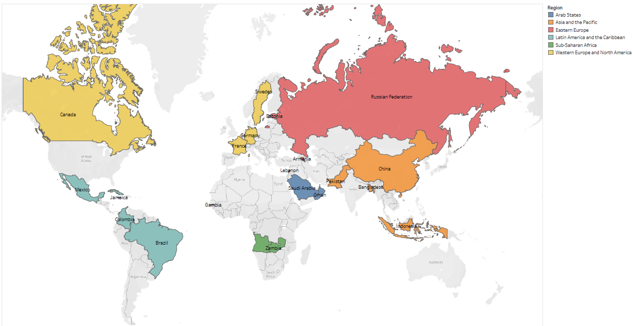
TCG Members
Session 1.d

Slide 6
TCG SDG4 Indicators
Our 2016-2020 Roadmap
TCG1 - Washington DC
May 2016
Institutional: Organization of the TCG and work proposal, I
IAEG-SDGs global indicator proposal; Proposal thematic set of indicators
TCG6 – Yerevan
Aug 2019
- Reporting 37 indicators
- 4.7.4, 4.7.5, 4.5.2
-Methodological development: benchmarks, 4.1.1, 4.1.2, 4.1.5, 4.3.1, 4.4.3, 4.5.2, 4.5.3, 4.7.1, 4.7.4, 4.7.5, 4.a.1, 4.c.1, 4.c.3, 4.c.5
- Deletion: 4.b.2
- Institutional: Global Coalition for Education Data (invite other organizations to contribute)
TCG2 – Madrid
Oct 2016
TCG3 – Montreal
Jun 2017
TCG4 – Dubai
Jan 2018
TCG5 – Mexico
Nov 2018
- Reporting: 29 indicators
- Methodological development: 4.7.2, 4.a.2, 4.3.1, 4.6.3, 4.b.2, 4.2.3, 4.7.1, 4.5.2, 4.5.3, 4.a.3
- Reporting: Placeholders/Indic
- Reporting 33 indicators
4.a.2, 4.a.3, 4.6.3, 4.7.2 Methodological development: monitoring education and equity, 4.2.3, 4.3.1, 4.5.2, 4.5.3, 4.6.3, 4.7.1, 4.7.2, 4.a.2, 4.a.3
Benchmarking discussion
- Reporting: 33 indicators
- Methodological development: 4.1.1, completion rate (4.1.2), OOSC (4.1.4), 4.2.3, 4.2.4, 4.3.1, 4.4.3, 4.5.2, 4.a.1(d)
- Results of Benchmark Consultation
TCG7 – Webinar
Oct 2020
- Reviewing Methodological development
- Covid-19 response
-Benchmark implementation
-Expansion of TCG membership
- Methodological development: Metadata for SDG4 indicators
Session 1.d

Slide 7
TCG meeting 2020: finalizing indicator development
Indicators not reporting
Indicator 4.5.3
Indicator 4.c.7 (today reduced to only OECD countries)
Indicator 4.c.5 on teachers
Indicator 4.7.3 on Human Rights
Indicator on breadth of skills
Increase coverage and data use
Refine indicators as needed
Develop strategies for covering data gaps to be filled and almost immediately available information
Increase the use of less traditional sources for data collection
Session 1.e

Slide 8
Education 2030 Framework for Action
Called on countries to establish “appropriate intermediate benchmarks (e.g. for 2020 and 2025)” for the SDG indicators, seeing them as “indispensable for addressing the accountability deficit associated with longer-term targets” (§28)
Consultation process
Political commitment: Benchmarks need to be feasible and based on national ownership.
Define benchmarks at regional level: common challenges and more opportunities to enter into policy dialogue
Technical issues: Measurement issues to resolve
Session 1.e
Notes:
Three objectives:
◆ Availability: identify data gaps that hamper SDG 4 monitoring
◆ Accountability: assess progress relative to feasible trends
◆ Actionability: lead to data collection and policy responses
Five principles:
◆ Fairness: benchmarks values take SDG 4 aspirations, initial conditions and feasible progress into account
◆ Efficiency: data to support benchmarks are available for most countries, on regular basis and in timely way
◆ Relevance: indicators linked to national and regional agendas and assessment of progress linked to policy responses
◆ Simplicity: benchmarks understood by all
◆ Transparency: process is verifiable and communicated clearly

Slide 9
Political process
Involve regional organizations to achieve alignment between global and regional education agendas and avoid duplication; and:
◆ confirm willingness to support a benchmarking process
◆ coordinate with organizations where memberships overlap
◆ identify steps leading to approval of benchmarks
Two aspects of flexibility in the process:
◆ any regional organization willing to lead the process can do so
◆ regional organizations may set additional benchmarks
Session 1.e

Slide 10
Covid-19 Response
Regional webinars and a dedicated webpage to COVID-19
Joint Survey on School Closures : a country-level survey of to monitor national education responses to COVID-19 school closures jointly with UNICEF and World Bank Group (WBG)
1st iteration: 118 countries across 8 regions (15 April 2020 - June 12, 2020
2nd iteration: 149 countries (15 July 2020 - 15 October 2020)
Survey to Planning Units a survey designed for Statistical Planning Units in Education to monitor COVID-19 pandemic impacts on national education planning units.
129 countries across 9 regions
Other Initiatives
Inter-Secretariat Working Group on Household Surveys (ISWGHHS), COVID-19 task force: co-chair with WBG
UN Wide effort on the impact of COVID
Session 1.e
Notes:
https://unstats.un.org/unsd/ccsa/documents/covid19-report-ccsa.pdf
https://unstats.un.org/unsd/ccsa/documents/covid19-report-ccsa_vol2.pdf

Slide 11
Thank you!

