Slide 1
TCG PROGRESS REPORT 2020-2021
Silvia Montoya
UIS Director

Slide 2
Introduction
Technical Cooperation Group on the Indicators for SDG 4 – Education 2030 (TCG)
7th Meeting – Virtual (October 2020)
1 working group - 1 plenary (Mid 2021)
Meeting and Consultation (June 2021)
1 - TCG progress and update on benchmarks
2 - Equity benchmarks
3 - Regional/global aggregates

Slide 3
TCG Meeting
and
Consultation
June 2021
TCG progress and update on benchmarks
Regional benchmarking process
Indicators for regional benchmarking
Equity benchmarks
October 2020: TCG approved a technical and political process for setting benchmarks
→ Exception: the 7th benchmark indicator on equity …. Since then, options have been explored and presented to TCG members
Regional/global aggregates
So far, reported for 5 of the 12 SDG 4 Global Indicators
Will be reported for almost all SDG 4 indicators for the first time in the 2021 UNSG SDG Report
Yet, agreement must be reached on the definitions and methodologies for regional averages for most SDG 4 indicators
Consultation and Voting
Equity indicator + Regional/Global aggregates for 4.1.1, 4.1.2, parity indices and finance indicators

Slide 4
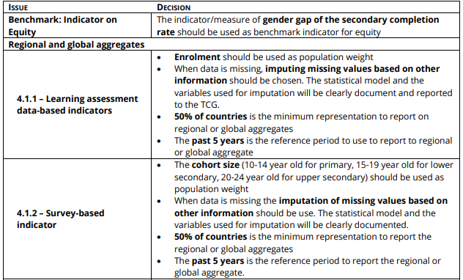
Consultation results summary (1)

Slide 5
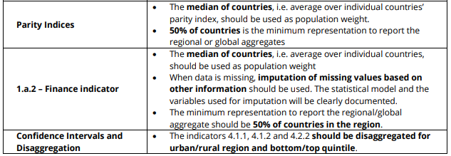
Consultation results summary (2)

Slide 6
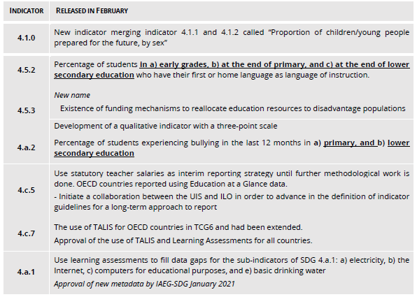
Indicator dissemination
Following 7th TCG meeting:
Changes in Titles
Added indicators

Slide 7
National benchmarks
UIS & Global Education Meeting (GEM) Report working closely with regional partners and Member States towards:
Endorsement of the minimum regional benchmarks by regional entities and their Member States who participated in various consultation rounds by July 2021
Submission by Member States of national benchmarks by 15 October 2021 in view of the next UNESCO General Conference in November 2021
All benchmark-related information is found on the TCG website, including the country, regional and global dashboards with minimum and feasible benchmarks for countries’ consideration.

Slide 8
TCG1 - Washington DC
May 2016
Institutional: Organization of the TCG and work proposal, IAEG-SDGs global indicator proposal; Proposal thematic set of indicators
TCG6 – Yerevan
Aug 2019
- Reporting: 4.7.4, 4.7.5, 4.5.2, 4.c.7 (37 indicators)
- Methodological development: benchmarks, 4.1.1, 4.1.2, 4.1.5, 4.3.1, 4.4.3, 4.5.2, 4.5.3, 4.7.1, 4.7.4, 4.7.5, 4.a.1, 4.c.1, 4.c.3, 4.c.5
- Deletion: 4.b.2
- Institutional: Global Coalition for Education Data
TCG2 – Madrid
Oct 2016
TCG3 – Montreal
Jun 2017
TCG4 – Dubai
Jan 2018
TCG5 – Mexico
Nov 2018
- Reporting: 29 indicators
- Methodological development: 4.7.2, 4.a.2, 4.3.1, 4.6.3, 4.b.2, 4.2.3, 4.7.1, 4.5.2, 4.5.3, 4.a.3
- Reporting: Placeholders/Indic
- Reporting:4.a.2, 4.a.3, 4.6.3, 4.7.2 (33 indicators)
- Methodological development: monitoring education and equity, 4.2.3, 4.3.1, 4.5.2, 4.5.3, 4.6.3, 4.7.1, 4.7.2, 4.a.2, 4.a.3, 4.b.2, benchmarking
- Reporting: 4.2.3, 4.7.1 reporting is discontinued (33 indicators)
- Methodological development: 4.1.1, completion rate (4.1.2), OOSC (4.1.4), 4.2.3, 4.2.4, 4.3.1, 4.4.3, 4.5.2, 4.a.1(d)
TCG7 – Virtual
Oct 2020
- Reporting: 4.c.5, 4.c.7
- Methodological development: 4.5.2, 4.a.1, 4.a.2
- Methodological development: Metadata for SDG4 indicators
TCG 8 - Virtual
- Adoption of Equity benchmark
- All indicators reporting
- Refinement of methodologies
- Review of institutional mechanisms of TCG

Slide 9
Thank you
Learn more: http://uis.unesco.org/
@UNESCOstat

